Slide 1
Inheritance and Pedigree Analysis
LS1201

Slide 2
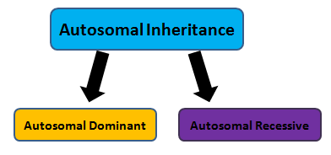
Autosomal inheritance in humans
Autosomal inheritance of a gene means that the gene is present on one of the autosomes.
Males and females are equally likely to inherit the gene.
Mutation of a gene in autosomal chromosome results in autosomal diseases.

Slide 3
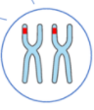
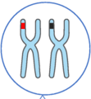
Autosomal inheritance in humans
Autosomal recessive disease- Only mutation in both the alleles of the gene present in the respective homologous chromosomes causes the disease.
Autosomal dominant disease- Mutation in any one of the alleles of the gene is sufficient to cause the disease.

Slide 4
Autosomal Inheritance
Autosomal Recessive Disorder
Autosomal Dominant Disorder
Autosomal recessive disorder means both the alleles of a gene must be abnormal to cause disease.
People with only one defective gene in the gene pair are not affected with the disease. They are carriers.
One must inherit two mutated genes, one from each parent to get the disease.
Autosomal dominant disorders occur when only one abnormal copy of an autosomal gene is sufficient to cause disease.
There can be no carriers for this type of disorder. So affected individuals have one normal and one mutated allele.
Autosomal dominant disorders can therefore be inherited from one affected parent having one abnormal copy of the gene

Slide 5
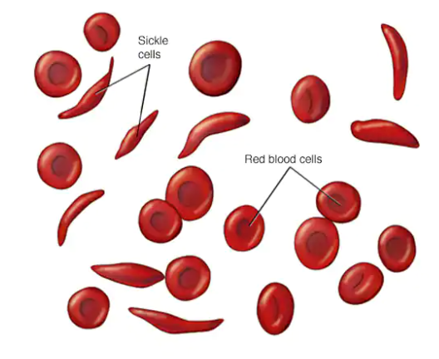
Autosomal Recessive Disorder
Examples:
Phenylketonuria (PKU)
Cystic fibrosis
Sickle cell anemia
Tay-Sachs disease.
Thalassaemia
Sickle cell anemia

Slide 6
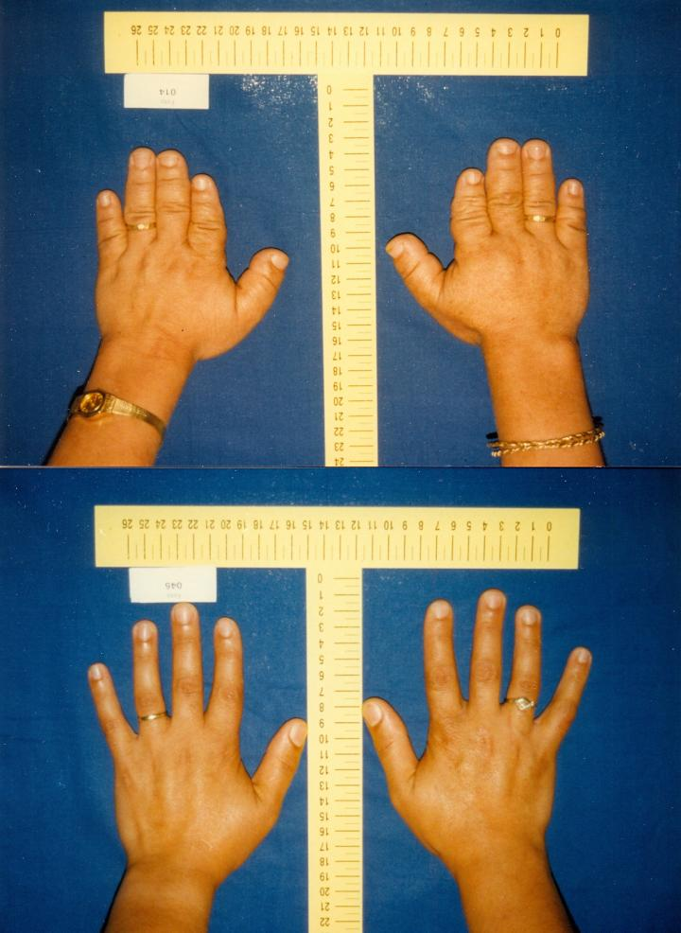
Autosomal Dominant Disorder
Examples:
Huntington’s disease
Pseudoachondroplasia
Marfan's syndrome
Brachydactyly
Brachydactyly

Slide 7
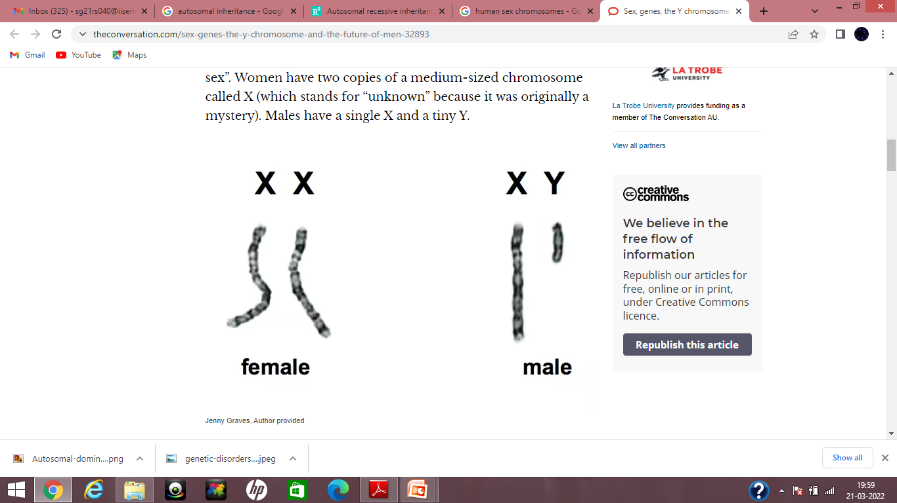
Human Sex Chromosomes
Sex of an individual is determined by a special pair of chromosomes called sex chromosomes.
Humans have 46 chromosomes: 22 homologous pairs of autosomes and 2 sex chromosomes.
Females: have a pair of identical sex chromosomes called the X chromosomes (XX)
Males: have a non-identical pair, consisting of one X and one Y ( XY).

Slide 8


Sex determination in humans
Females- During meiosis the two X chromosomes pair and segregate like autosomes so that each egg receives one X chromosome.
Males – During meiosis the X and the Y chromosomes pair over a short region, which ensures that the X and Y separate creating two types of sperm. So half of the sperms have X and the other half have Y.
XX
XY

Slide 9
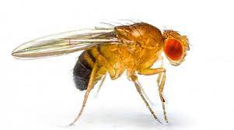
Drosophila melanogaster- Model organism for studying sex linked inheritance
Inheritance patterns of sex chromosomes was first investigated in the fruit fly Drosophila melanogaster.

Slide 10
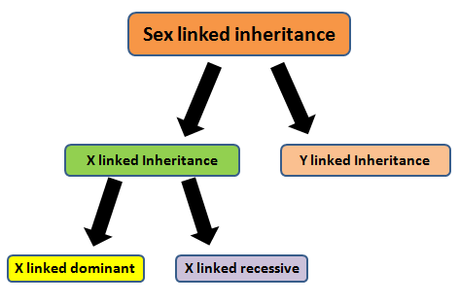
Sex linked Inheritance
Sex-linked diseases are passed down through families through the sex chromosomes- X or Y chromosomes.

Slide 11
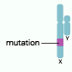
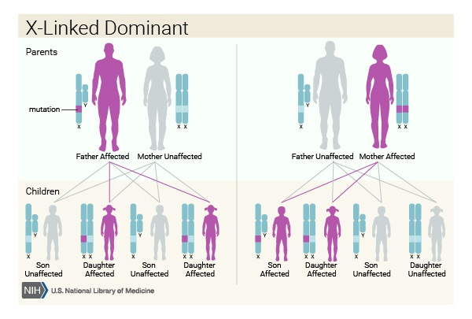
X linked Recessive Inheritance
These disorders are caused by gene defects on the X chromosome.
Males have only one X chromosome so one altered copy of the gene in each cell is sufficient to cause the disease.
Females have two X chromosomes so both the gene copies should be altered to cause the disorder.
Males are affected by X-linked recessive disorders much more frequently than females.
mutation

Slide 12
X linked Dominant Inheritance
These disorders are caused by gene defects on the X chromosome.
Males have only one X chromosome so one altered copy of the gene in each cell is sufficient to cause the disease.
Females have two X chromosomes but since this is a dominant disorder so alteration in any one gene copy is sufficient to cause the disorder.
mutation

Slide 13
X linked Recessive Inheritance
Examples:
Haemophilia A and B
Duchenne Muscular Dystrophy
Glucose 6 phosphate dehydrogenase deficiency
Color blindness
X linked Dominant Inheritance
Examples:
Vitamin D resistant rickets

Slide 14
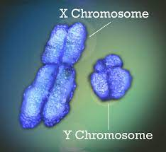
Y linked Inheritance
Y linked trait passes through Y chromosome from father to son.
Such traits cannot be passed to daughters because they do not inherit Y chromosomes.

Slide 15
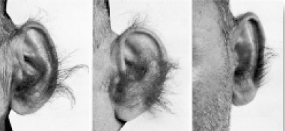
Y linked Inheritance
Examples:
Hypertrichosis of the ears (hairy ear)
webbed toes
Hypertrichosis (hairy ear rims)

Slide 16
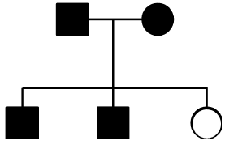
Pedigree
Pedigree chart displays the members of a family affected by a genetic disease in the form of a family tree.
Pedigree analysis is the study of such a chart to detect genetic diseases in a family by studying the inheritance of genes in humans

Slide 17
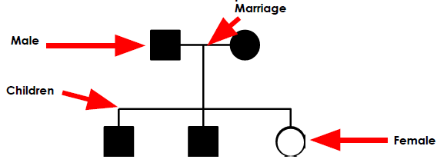
Pedigree
A shape represents each individual of the family.
Squares represent males.
Circles represent females.
Lines connect the individuals to each other.
A horizontal line connecting a male and female represents marriage.
A vertical line and bracket connects parents to their children.

Slide 18
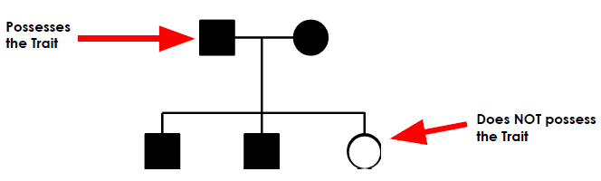
Pedigree
If a family member possesses a particular trait then the shapes are shaded to indicate it
If an individual does not possess a trait, then the shape is not shaded.
If there are any family member who are heterozygote or carrier then the shapes are half shaded.

Slide 19
Pedigree Use of a pedigree chart:
Pedigrees can help predict the genotype of family members.
If a trait is dominant, then all the family members who lack the trait must be homozygous recessive.
If parents express the trait but at least one of their children does not, then the parents must be heterozygous for the trait.
Pedigrees are only helpful in predicting genotypes of individuals for a trait that is controlled by a single gene.

Slide 20
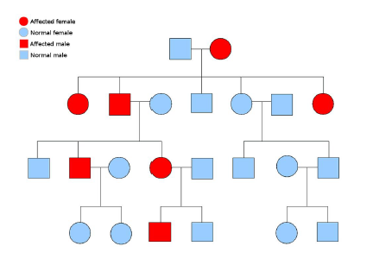
Pedigree
Autosomal dominant diseases usually appear in every generation of a family.

Slide 21
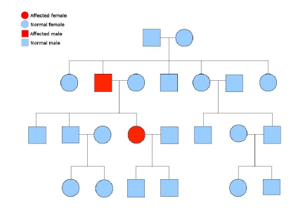
Pedigree
Autosomal recessive diseases appear less frequently in generations of a family.

Slide 22
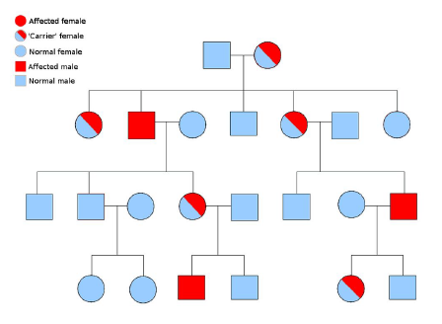
Pedigree
X-linked recessive diseases appear more often in males.
A male will be affected if he inherits just one copy of the disease gene because males only have one X chromosome.

Slide 23
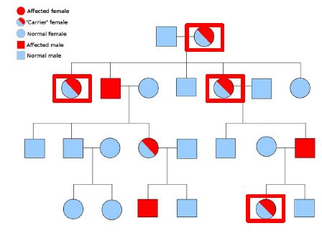
Pedigree
A heterozygous female who carries a disease gene but does not express an X-linked recessive disorder is called a carrier.

Slide 24
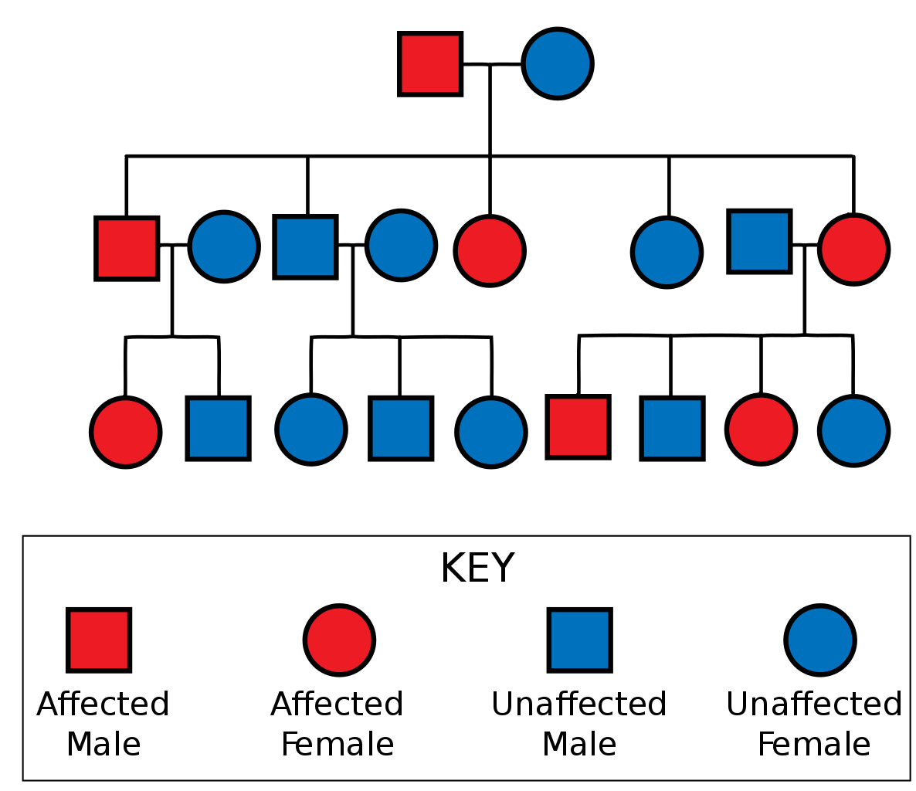
Pedigree
In X linked dominant disorder, a female will get the disease even if she has one diseased gene copy
Fathers cannot transmit the disease to sons as they get only Y chromosome from their father.

Slide 25
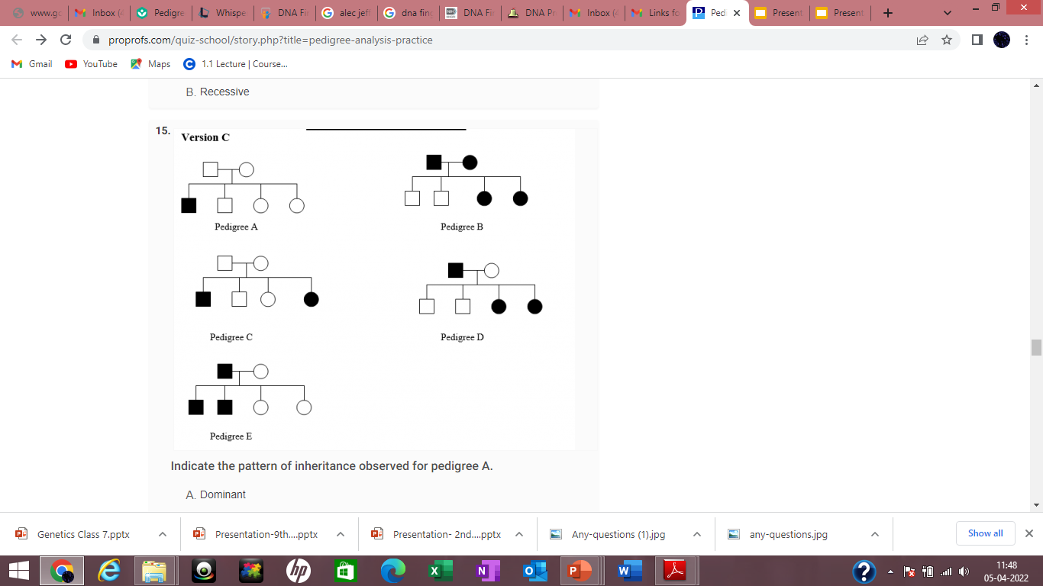
Indicate the pattern of inheritance.
A. Dominant
B. Recessive

Slide 26
Indicate the pattern of inheritance.
A. Autosomal dominant
B. Autosomal recessive
C. Sex linked dominant
D. Sex linked recessive

Slide 27
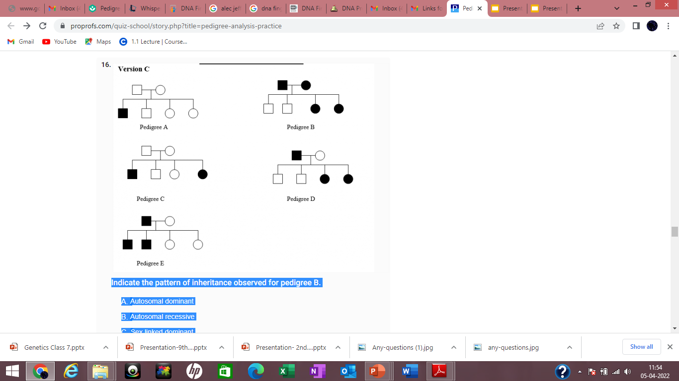
Indicate the pattern of inheritance.
A. Autosomal dominant
B. Autosomal recessive
C. Sex linked dominant
D. Sex linked recessive

Slide 28
Indicate the pattern of inheritance
A. Dominant
B. Recessive

Slide 29
Indicate the pattern of inheritance.
A. Autosomal
B. X-Linked
C. Y-Linked

Slide 30


